Slide 1
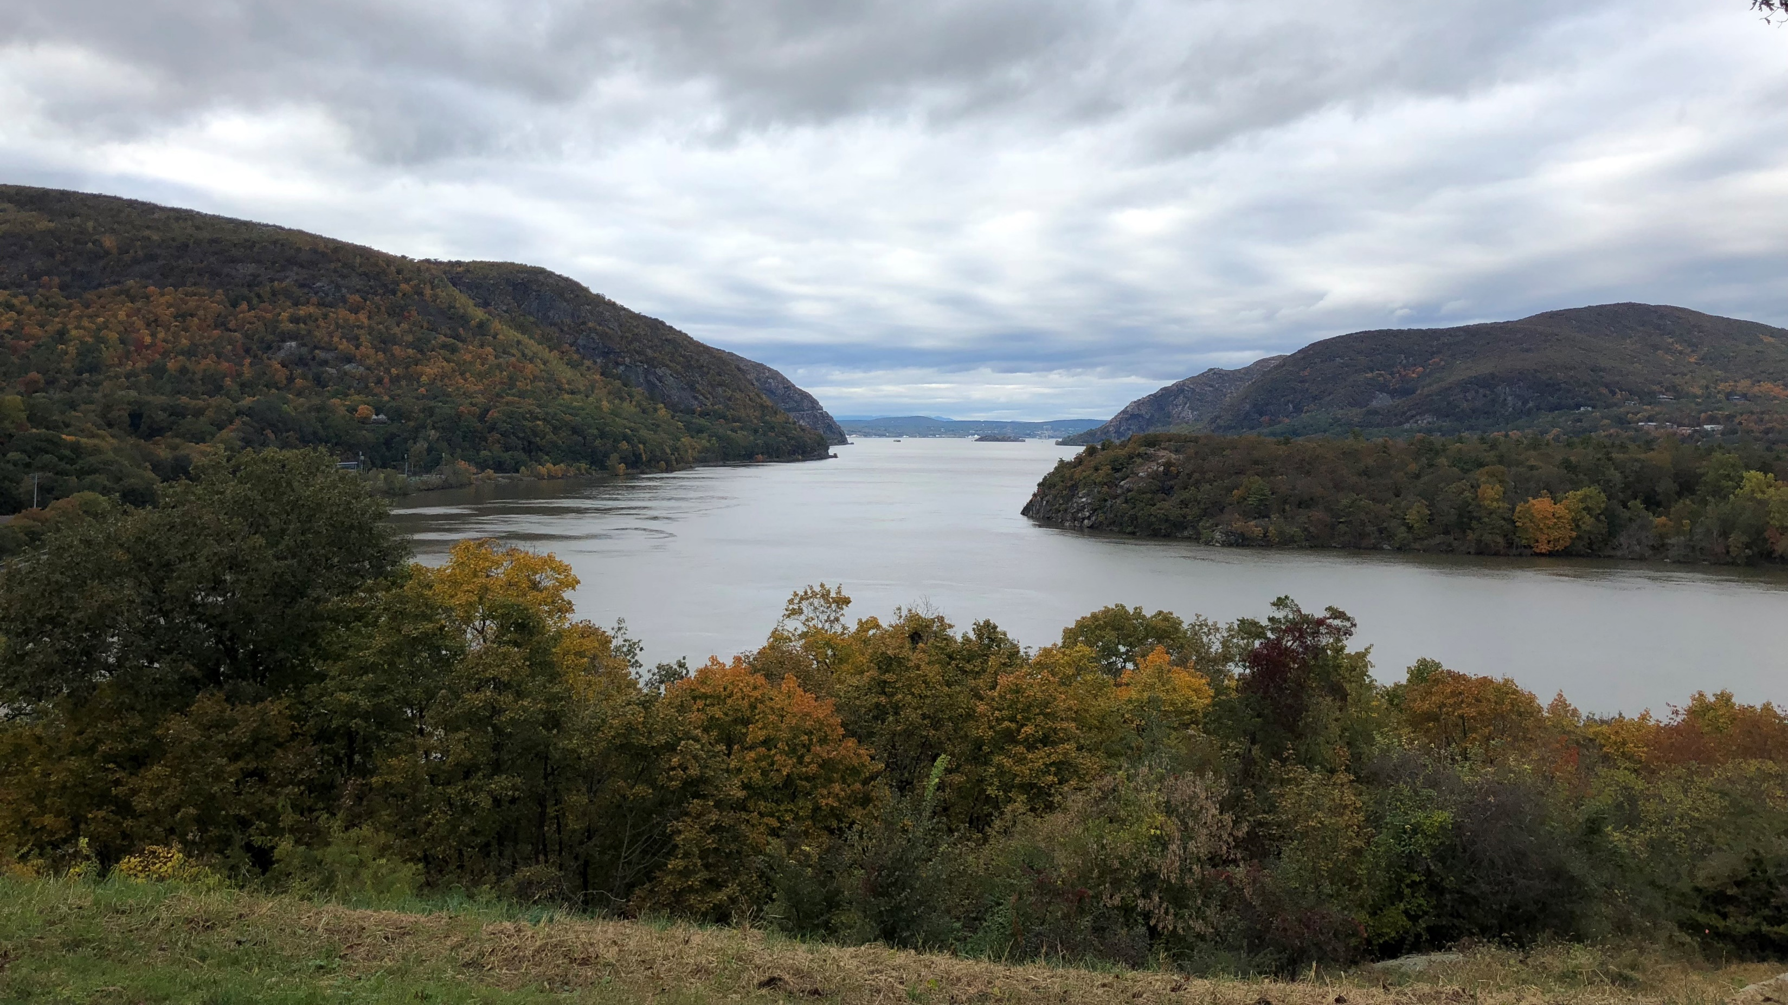
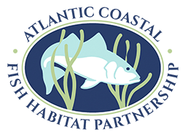
The Atlantic coastal fish habitat partnership
MAKING THE CONNECTION
Lisa Havel, ACFHP

Slide 2
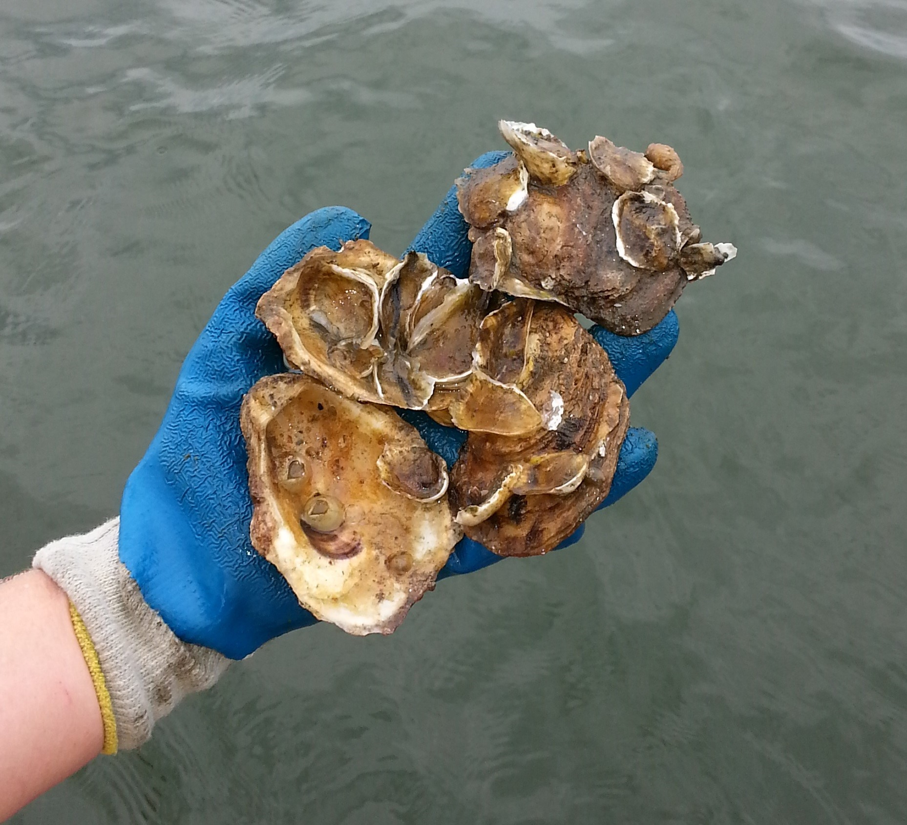
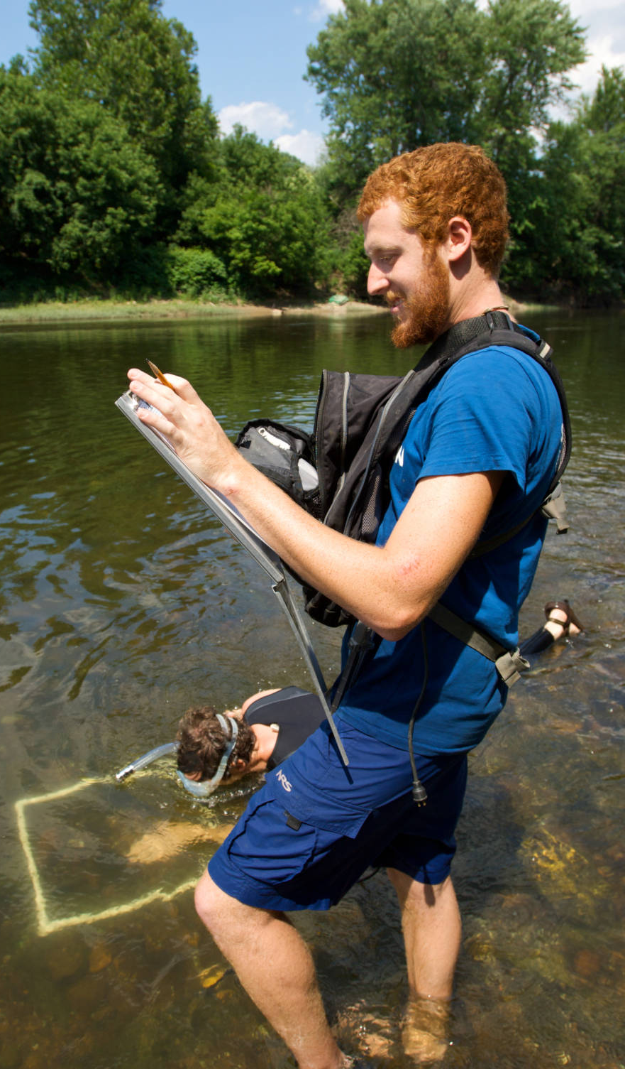
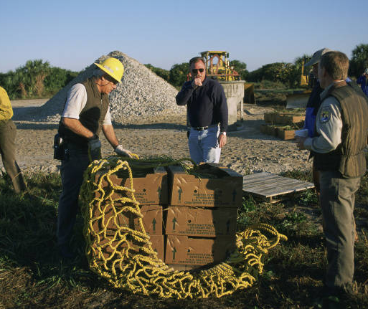
Who We Are
A coastwide collaboration of over 30 different state, federal, tribal, and nongovernmental entities.
Our Vision
TNC
Healthy, thriving habitats of sufficient quantity and quality to support all life stages of Atlantic coastal, estuarine-dependent, and diadromous fishes.
USFWS
Phillip Westcott, USFWS
Notes:
Need to add photo credits for these images

Slide 3
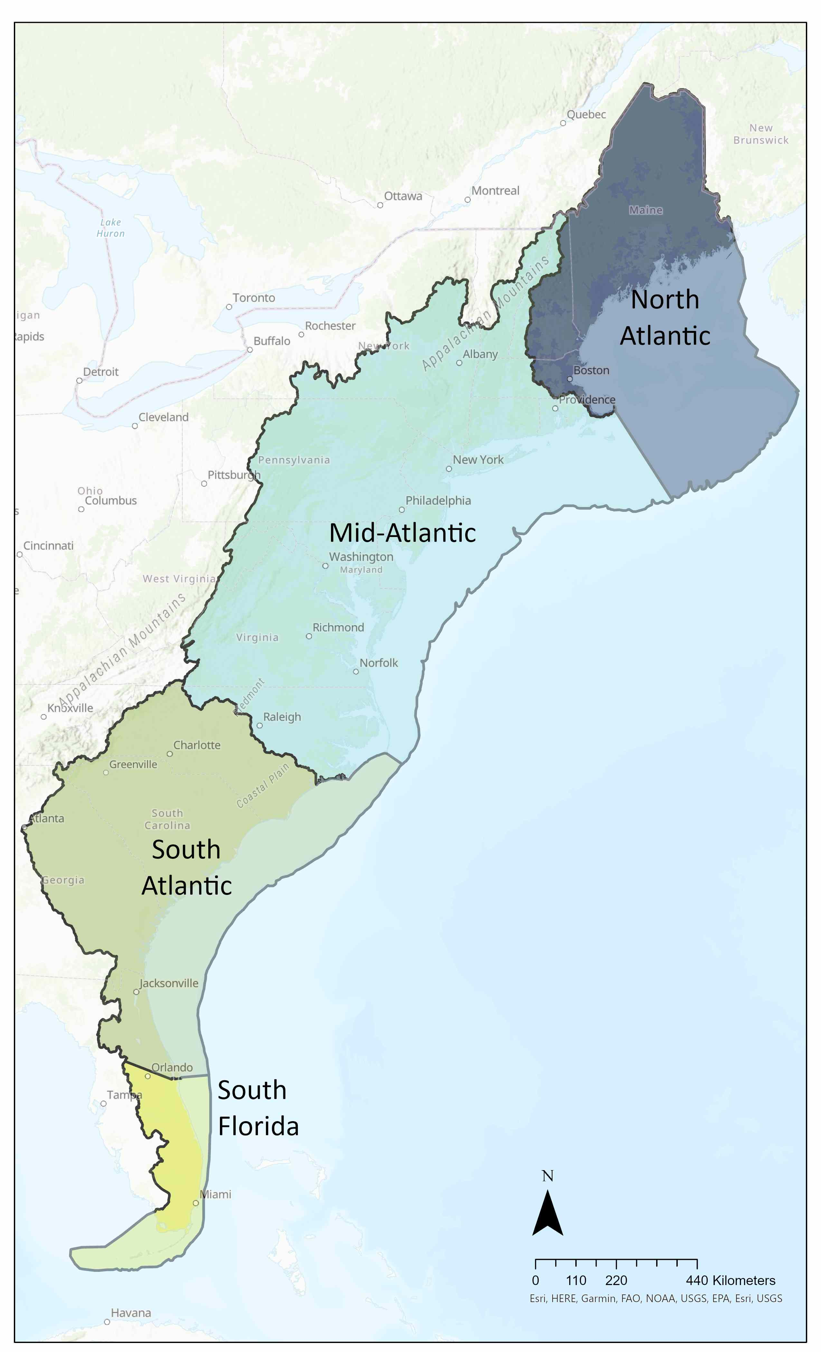
Where We Work
Within four subregions from Maine to the Florida Keys, each with their own priority habitats.
We work from the headwaters of rivers to the edge of the continental shelf, with a focus in estuarine environments.
Map Credit: Tayler Fewell, ACFHP
Notes:
Need to fix the legend and remove priority habitats

Slide 4
What We Do
We make the connection
Between fish and people
From headwaters to the ocean
Between partners
National to the local level
Protect,
Restore,
Enhance fish habitat
So everyone can enjoy healthy
Rivers
Estuaries
Coasts

Slide 5
How We Do It
Science
On-the-Ground Conservation
Partnerships

Slide 6
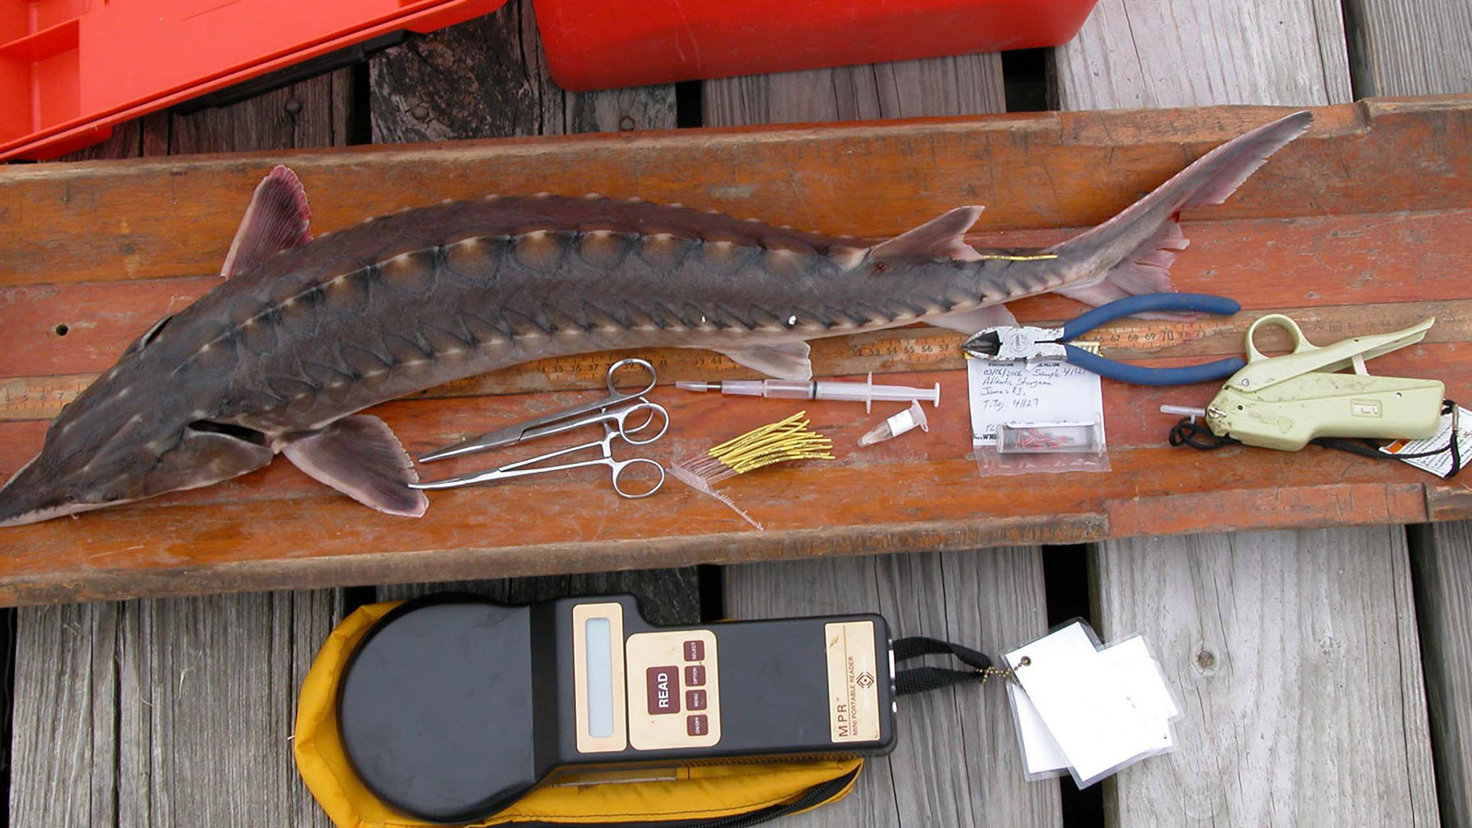
Science
Our Species – Habitat Matrix
Identifies the value of habitat for fish survival
Featured in Science Magazine, Huffington Post, and Awesome Ocean
Analyzes 100 species, 26 habitats, & 4 life stages
Over 2,000 views and 450 downloads
Albert Spells, USFWS

Slide 7
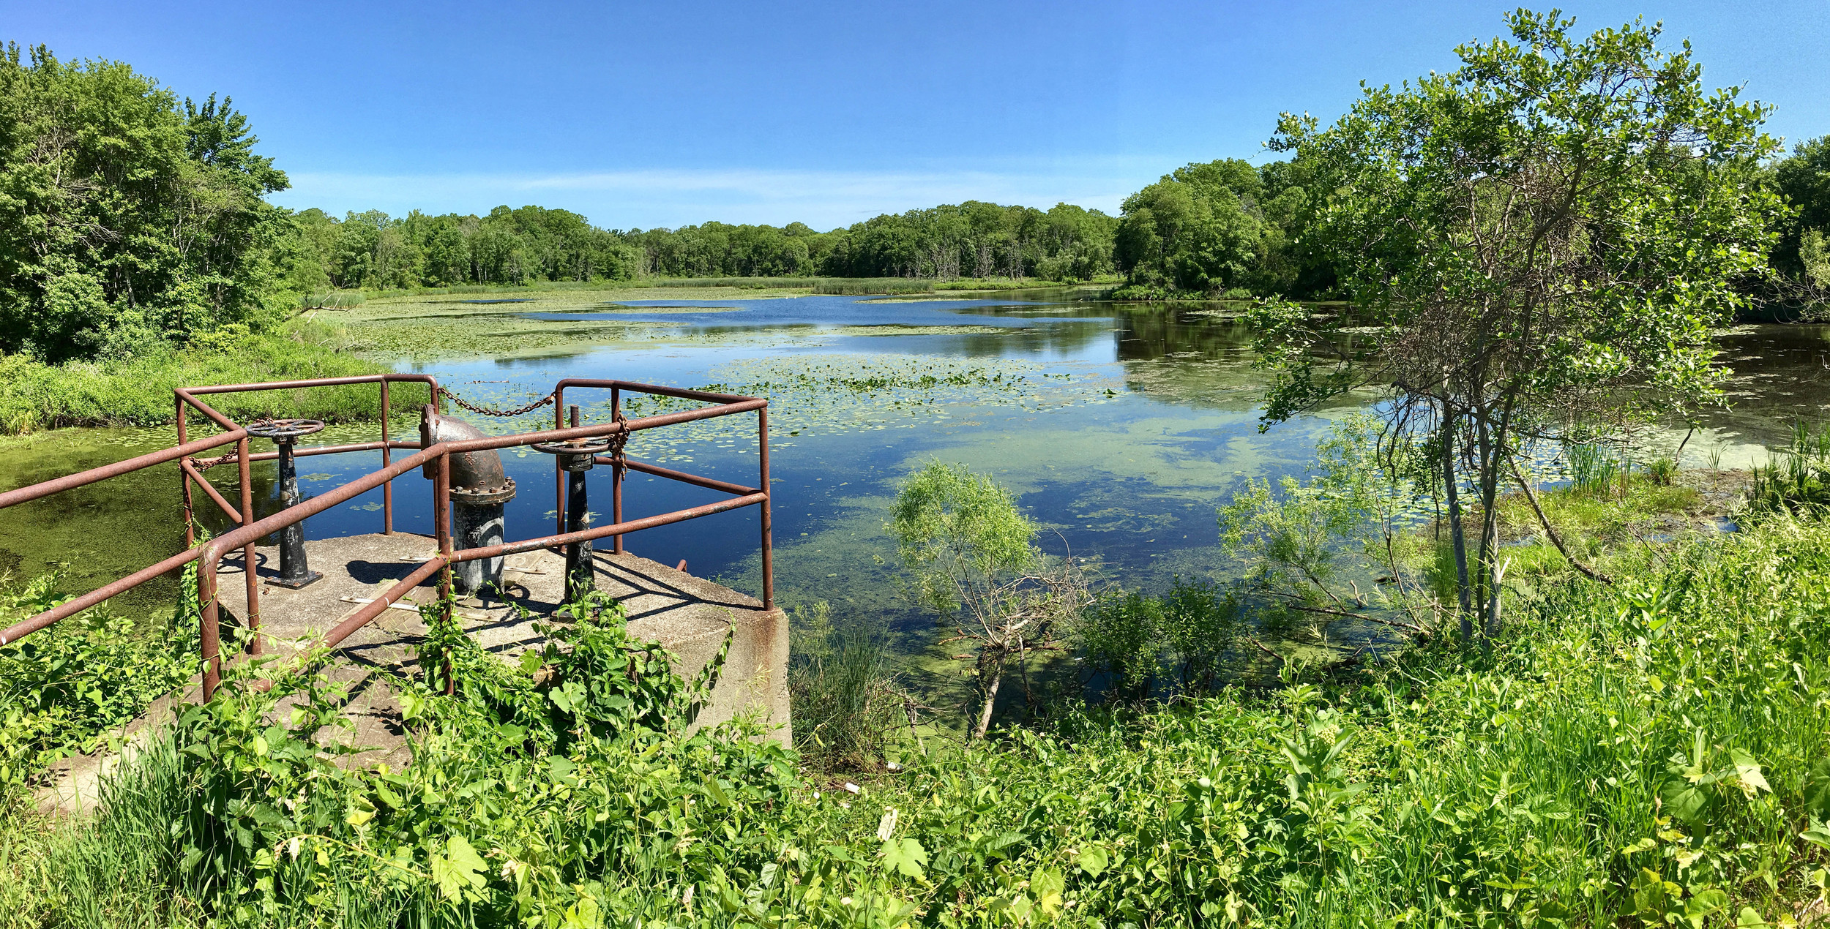
On-the-Ground Conservation
ACFHP has directly funded projects that have:
Restored 75+ acres of fish habitat
Reconnected over 390 miles of rivers and streams
Opened access to over 14,500 acres of previously inaccessible habitat
An economic value of over $125 million
Ted Hayes, Save the Bay
Notes:
Need to add photo credits

Slide 8
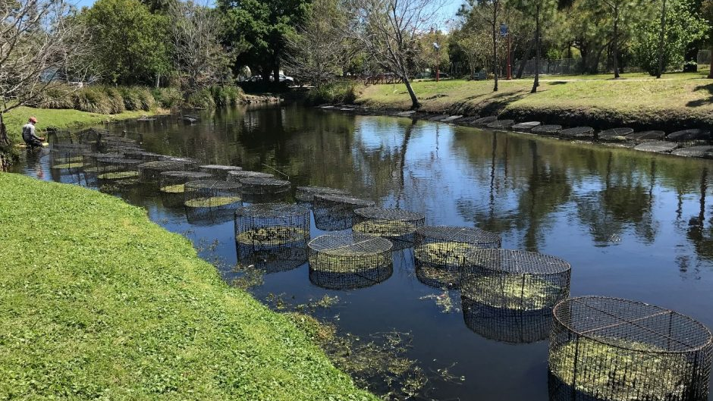
Partnership
Leverages funding and expertise to maximize results
Leverages an average of over $15 to over $1 spent on the ground
Works with experts to develop scientifically-driven conservation goals, priorities, and objectives
Shares knowledge and experiences throughout our geographies to increase success
FL FWC
Notes:
Need to add photo credit

Slide 9
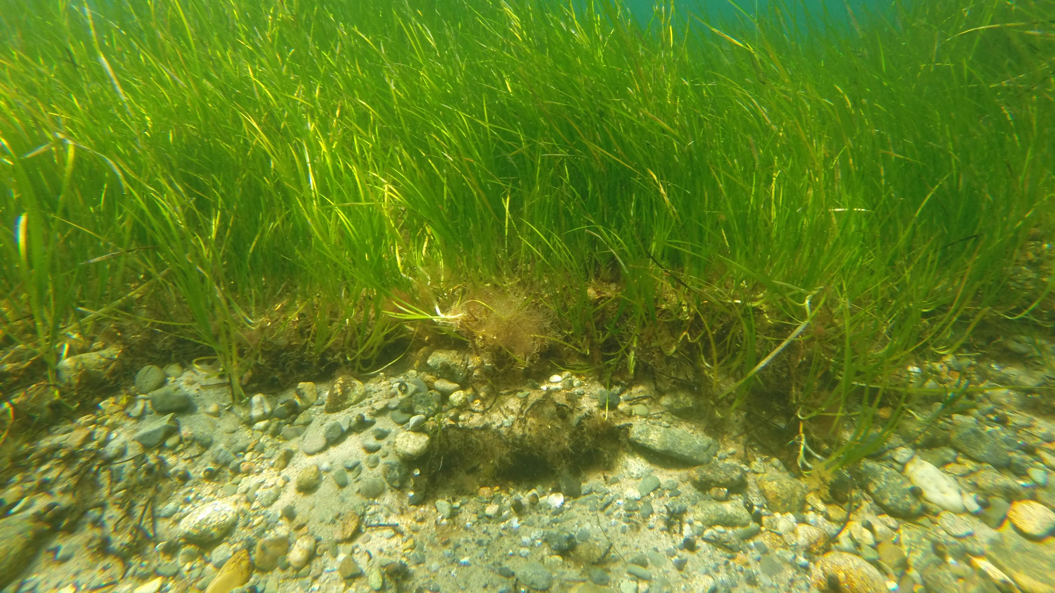
Submerged Aquatic Vegetation
Plants that live below the water’s surface in large meadows or small patches in coastal & estuarine waters.
Priority habitats in ACFHP’s North, Mid-, South Atlantic, and South Florida Subregions
Removes excess CO2 and add oxygen to the water
Is 2x more effective at storing carbon than terrestrial forests by acreage
US EPA

Slide 10
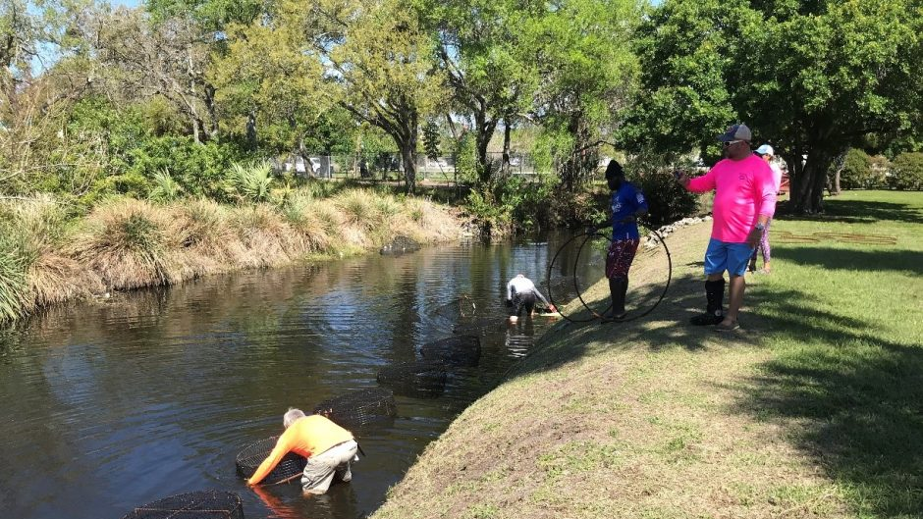
Riverine Bottom
Riverine bottom from the headwaters to the coast
Priority habitats in ACFHP’s North, Mid-, and South Atlantic subregions
Serves as spawning and nursing grounds for many species, including American eel, river herring, shad and Atlantic sturgeon
Sediments hold invertebrates and vegetation that provide food for many fish species
FL FWC

Slide 11
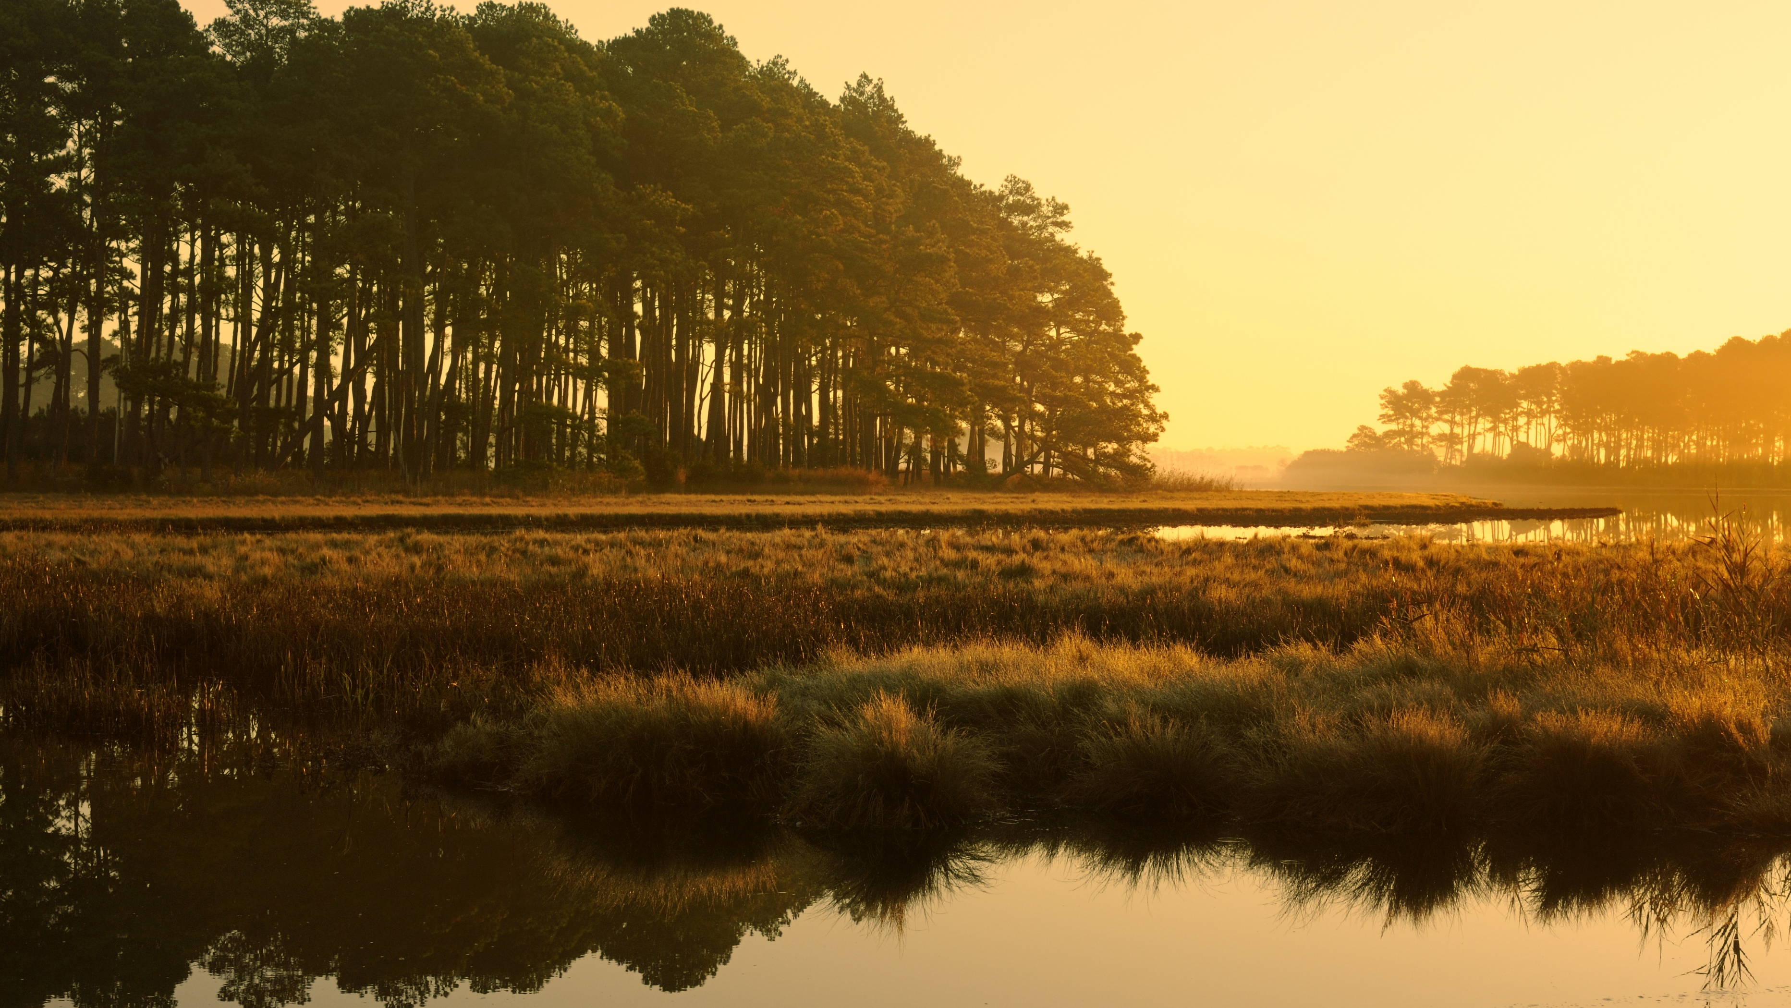
Tidal Vegetation
Marshes found in estuaries and freshwater environments
Priority habitats in ACFHP’s Mid-, South Atlantic, and South Florida subregions
Filters out pollutants and contaminants, sequesters 2-4x more carbon per acre than tropical forests
Offers coastal communities protection from storms, floods, and sea level rise
Shutterstock/ JuneJ

Slide 12
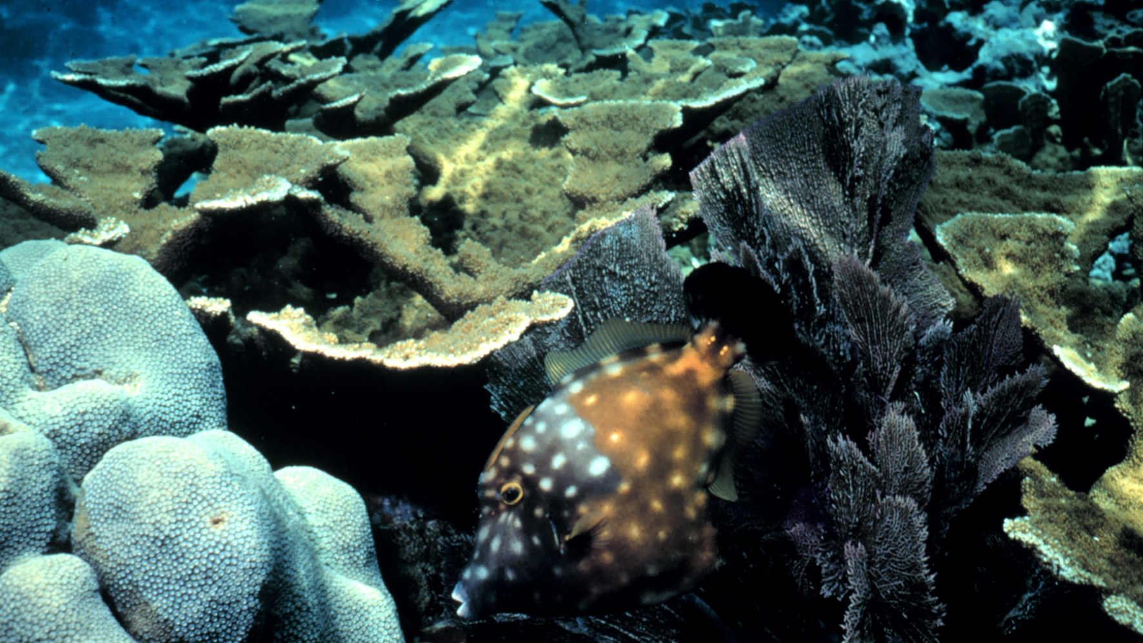
Coral and Live/Hard Bottom
Includes coral reefs, patch reef, soft corals, anemones, live rock, and macroalgae
Priority habitat in ACFHP’s South Florida subregion
Provides habitat to 25% of all marine life
Protects coastal communities against storm surge, provide food for people and marine organisms
Important source of biomedical chemicals
Harold Hudson, NOAA

Slide 13
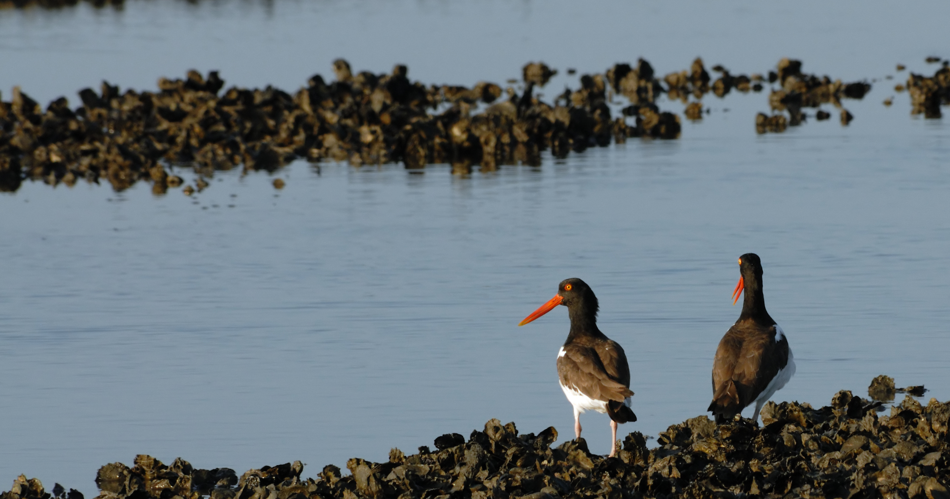
Marine and Estuarine Shellfish Beds
Oyster reefs, scallop and hard clam beds, and shell accumulations
Priority habitats in ACFHP’s North, Mid-, and South Atlantic subregions
Excellent at removing excess nutrients, contaminants, and sediments from the water column
Provides habitat and food for estuarine species and reduces the threat of coastal erosion
Shutterstock/Frederick J. Home

Slide 14
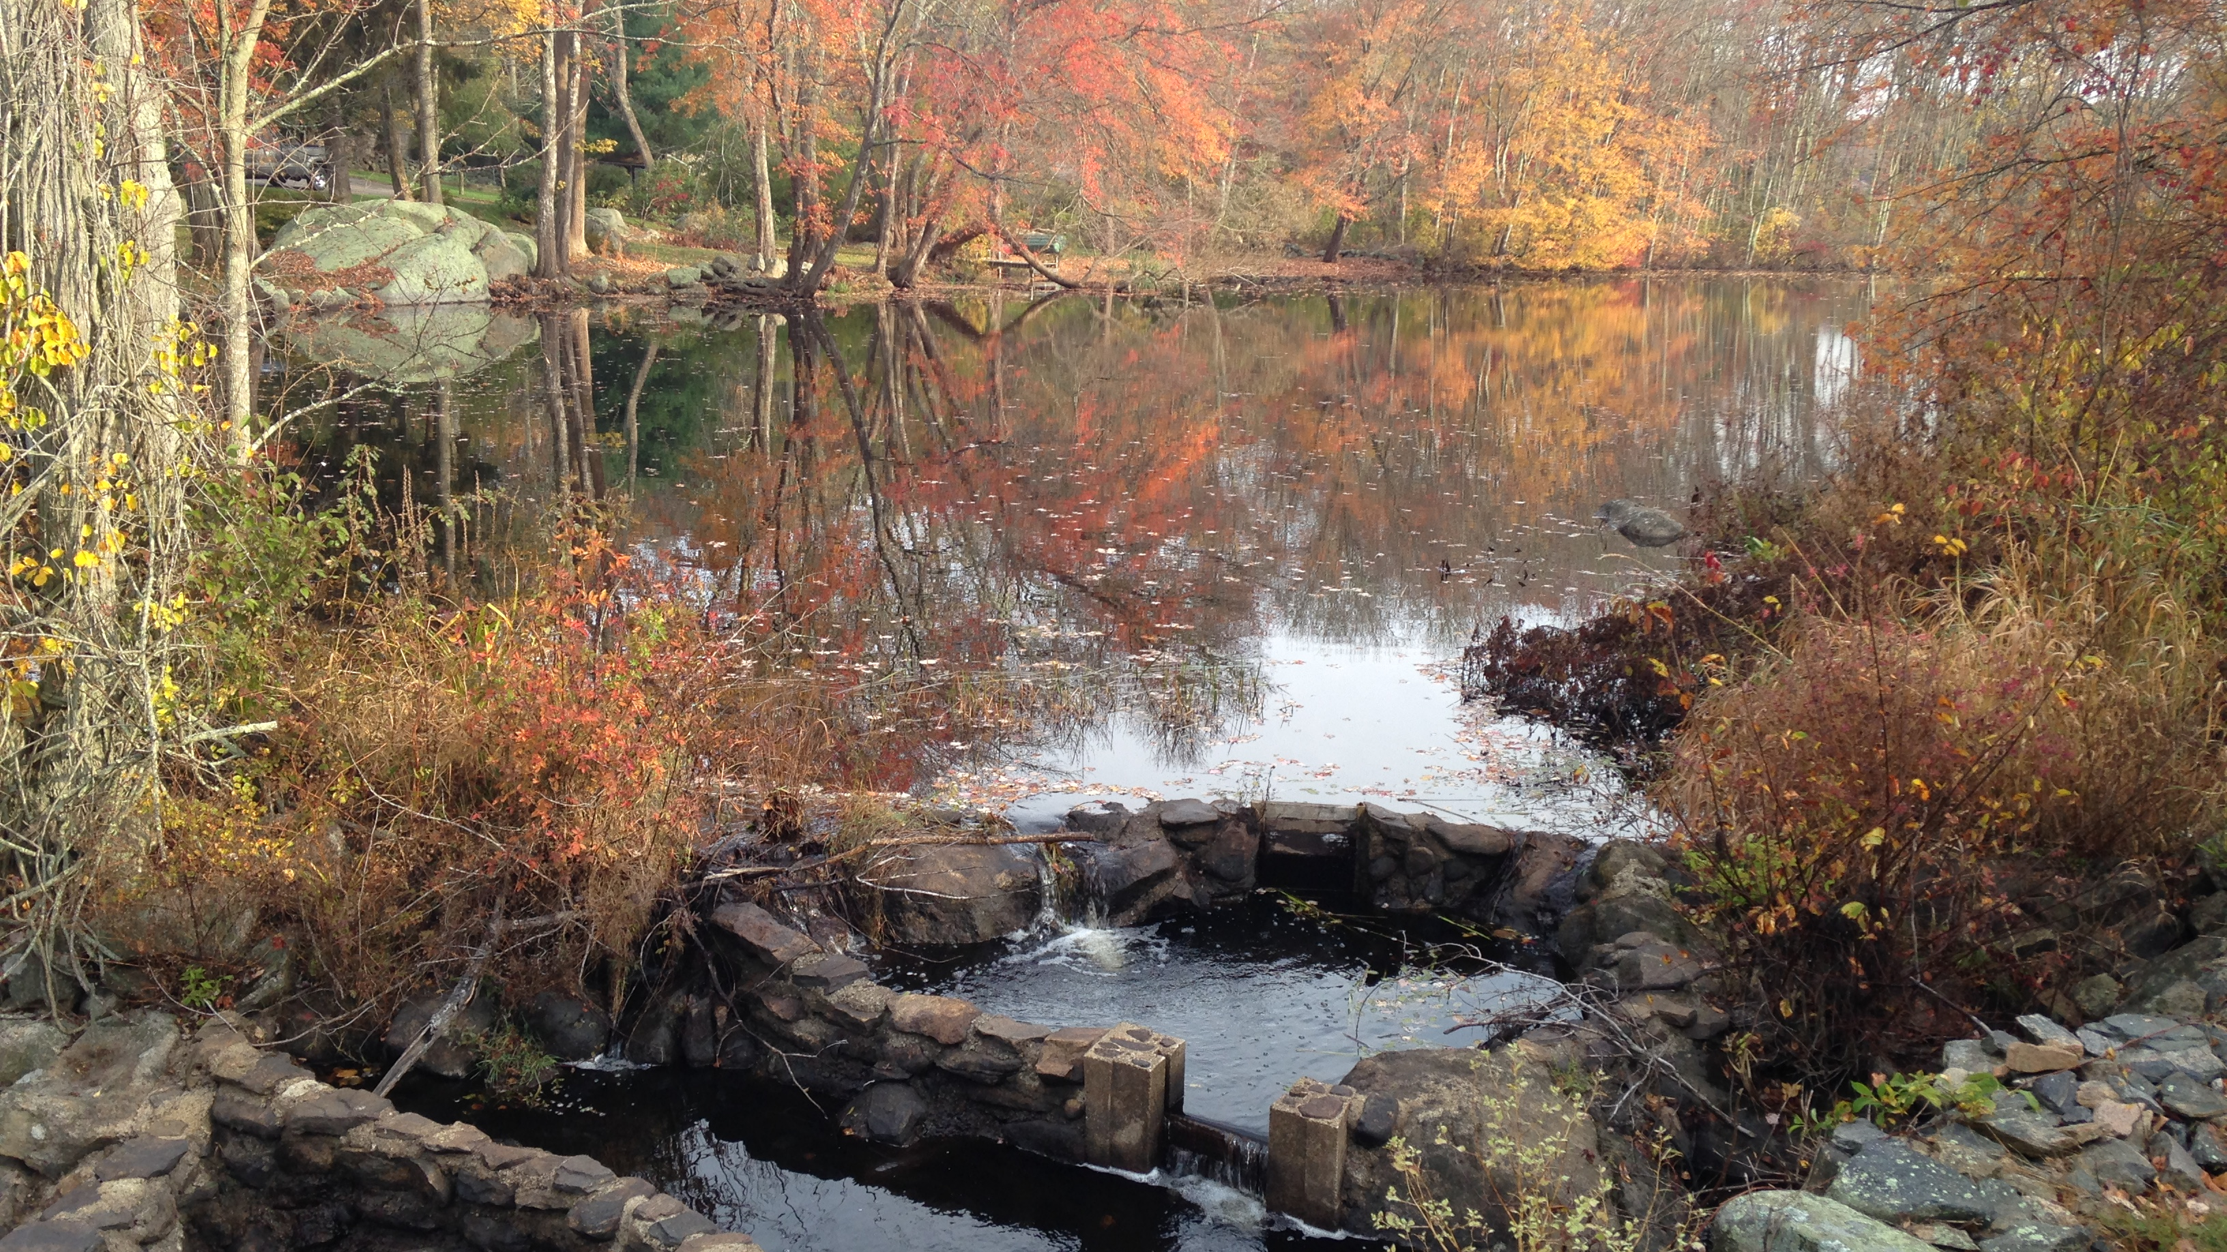
To Get Involved:
Donate to ACFHP
Become a partner
Apply for funding or endorsement
Subscribe to our newsletter
For More Information:
Visit us at:
www.atlanticfishhabitat.org
Email:
ACFHPinfo@asmfc.org
Follow us on Facebook:
Facebook.com/ACFHP
Lisa Havel, ACFHP
Notes:
Need to add photo credit

Slide 15
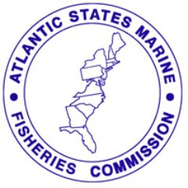
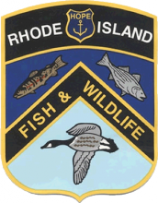
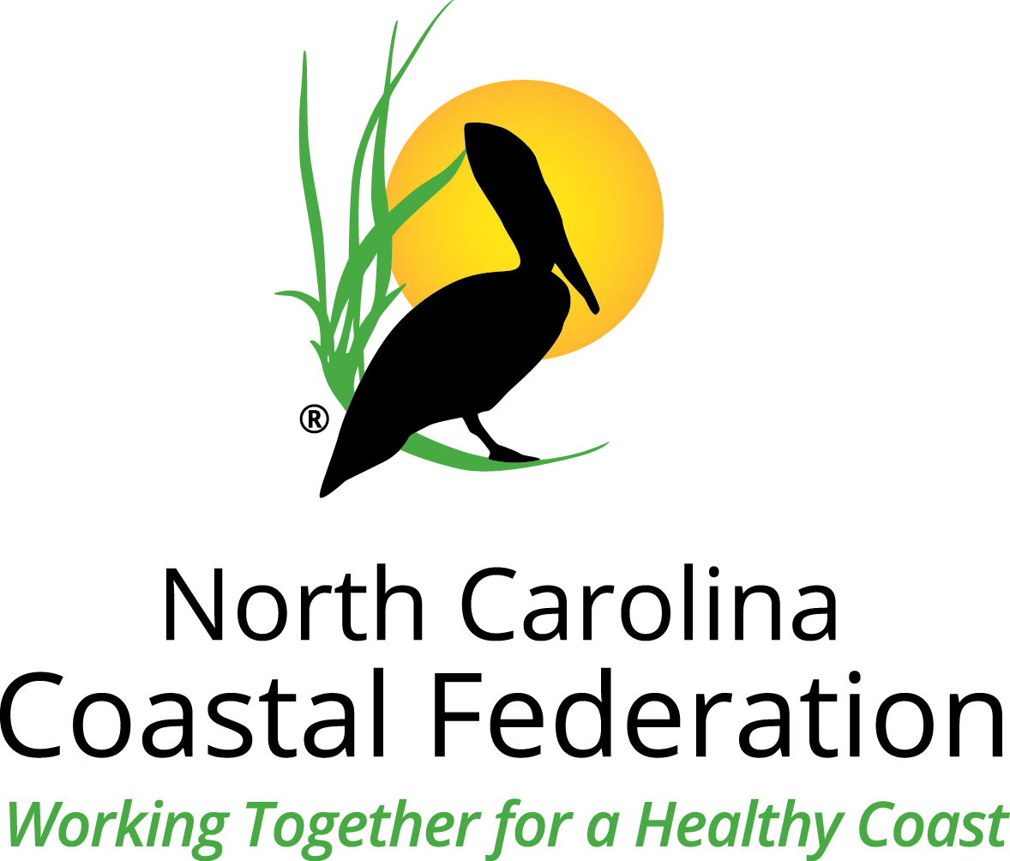
ACFHP PARTNERS

